Slide 1
Data Visualization
Class - 3
Instructor: Patrick Stingley
Email: Stingley@KSU.EDU
Notes:
Welcome to CIS-XXX, Data Visualization – Class 3
Did you put your resume out there?
Please record how many responses you got as of the first week so we can compare it later on
Last class you were asked to
Produce a .csv file containing 100 random numbers between 1 and 100 inclusive. Save that file as 100.csv.
How’d that work out?
Then in VSCode you prompted Copilot to create an Excel spreadsheet named months.xlsx.
Then we populated Column A with the names of the 12 months of the year starting with January.
In Column B, place 12 random numbers with values between 1 and 100 inclusive.
Did you make the pie chart and the donut chart?
Please e-mail me with the URL to your GITHUB repository so I can see your progress.
So, what did you think of having VSCode produce the test data? Pretty cool, eh?
And then posting data directly into the spreadsheet.
Did you get VSCode to put the bar chart into it?
When I first did this my mind exploded with all the things I could do.
So how many copies of ER Win did we have? Did you find the one labelled CA_ERWin?
Computer Associates bought ERWin and re-branded the software with their name on it.
This was a good and a real example of what I mean about the need to clean up the data.
When I first started working with that dataset, I had 1.4million reords, which was too big for Excel
So, First, I had to write a program to count up the numbers of each kinds of software before I could put it into Excel to analyze it.
It made it easier to count if all of the software was sorted together, so I first sorted it, then counted it.
I didn’t do that to you.
There are people who are dealing with really huge datasets, like all of the phone calls made across the United States.
Clearly, that isn’t going to fit into an Excel spreadsheet. In those cases you’d have to write some code to consolidate
the data to a manageable form.

Slide 2
Amounts
Some diagrams are commonly used to display amounts.
Two coordinate systems
Polar
Pie Charts
Donut Charts
Spider Diagrams
Cartesian
Histograms
Bar Charts
Horizontal Bar Charts
Grouped Bar Charts
Stacked Bar Charts
Box Plots
Tree Maps
Notes:
In the last class we began talking about charts that show amounts.
This time we’re going to continue that discussion and talk about graphics that show amounts
Using Cartesian coordinates:

Slide 3
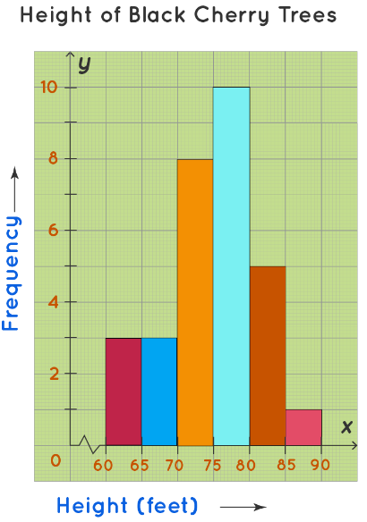
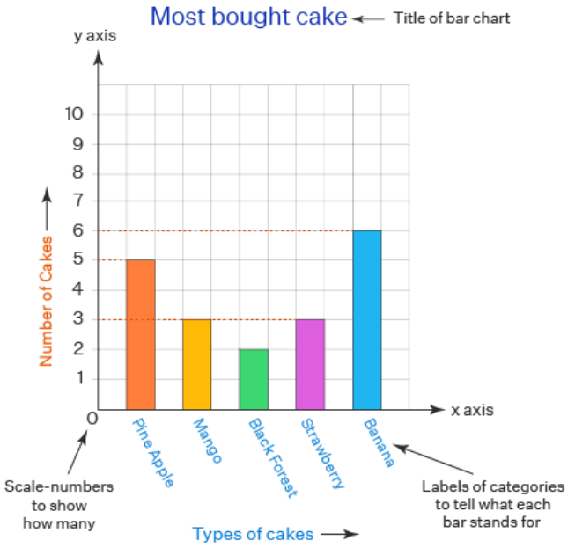
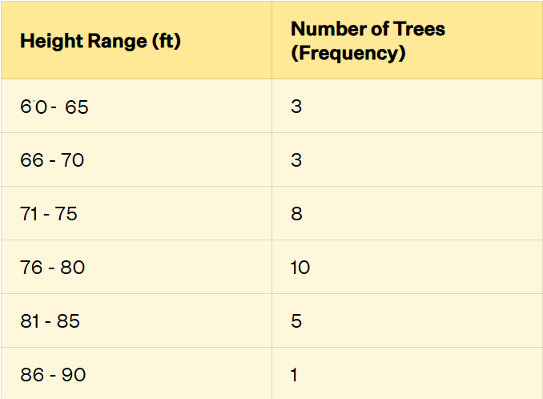
Histograms
Histograms vs Bar Charts
Histograms display continuous data
(no spaces)
Bar Charts
https://www.cuemath.com/data/histograms/
(Corrected)
https://www.cuemath.com/data/bar-chart/
Notes:
Histograms vs Bar Charts
I feel a little silly teaching this:
Here is a bar chart, but it turns out there are some things that you probably didn’t know.
Histograms display continuous data (no spaces)
Bar Charts display categories (Spaces)
One of the recommended books on the list for this course is “Fundamentals of Data Visualization” by Claus O Wilke. Several times he has diagrams of bar charts when he should be showing a histogram or vice versa. It’s an excellent book, with this one exception. I wrote to him. He’s a professor at the University of Texas at Austin and he just got incensed. I provided references too. Anyway, it’s a good book, but a bar chart has separate bars and a histogram doesn’t. With a Histogram, the bars are joined together to demonstrate that nothing falls in the gaps.
That Corrected in parentheses means that the author made an error and I had to change the values somewhat. I wrote to that author too.
Data clean up, what can I say? Can’t do data visualization without it.
Note the zig zag line on the histogram, showing that the X Axis has been truncated.

Slide 4

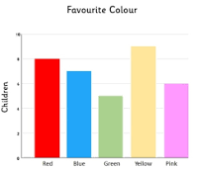
Bar Charts
Fundamentals of Data VIsualization
https://www.cuemath.com/data/bar-chart/
Notes:
Bar Charts are actually the horizontal bars, like the one on the left. The one on the right is actually called a column chart, because it is made of columns. Unlike Histograms, Bar charts are specifically for pre-defined categories. They are not appropriate for continuous data because things would fall in the cracks.

Slide 5
Column Charts
https://www.cuemath.com/data/bar-chart/
Notes:
You can see the column chart in a little more detail

Slide 6
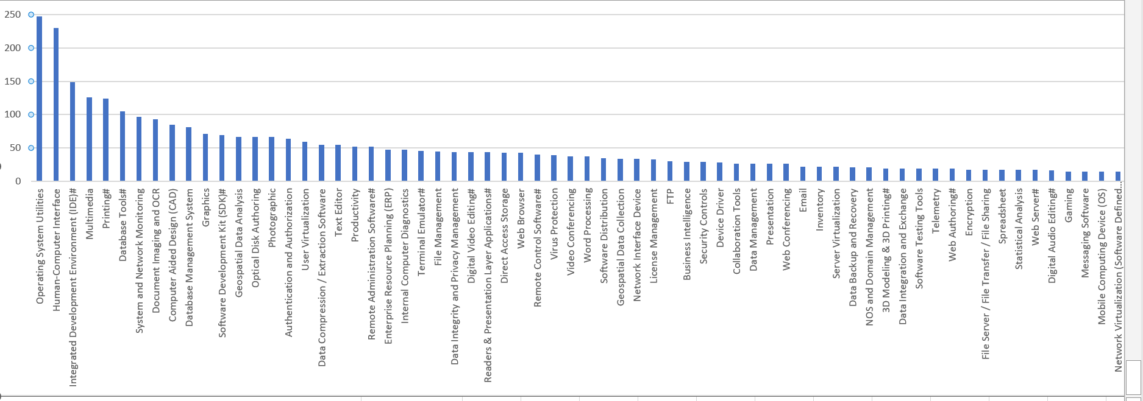
Column Charts
Here’s another one of mine
Notes:
You know they say, do as I say, not as I do?
Here’s one of mine. You might recognize the data from last time’s homework. I tried to show the relative proportion of software categories, but it was too big for a page.
The second thing you need to see is the slanted text. Avoid this if at all possible. I think I read that the cognitive load goes up 250% when people have to read sideways.

Slide 7
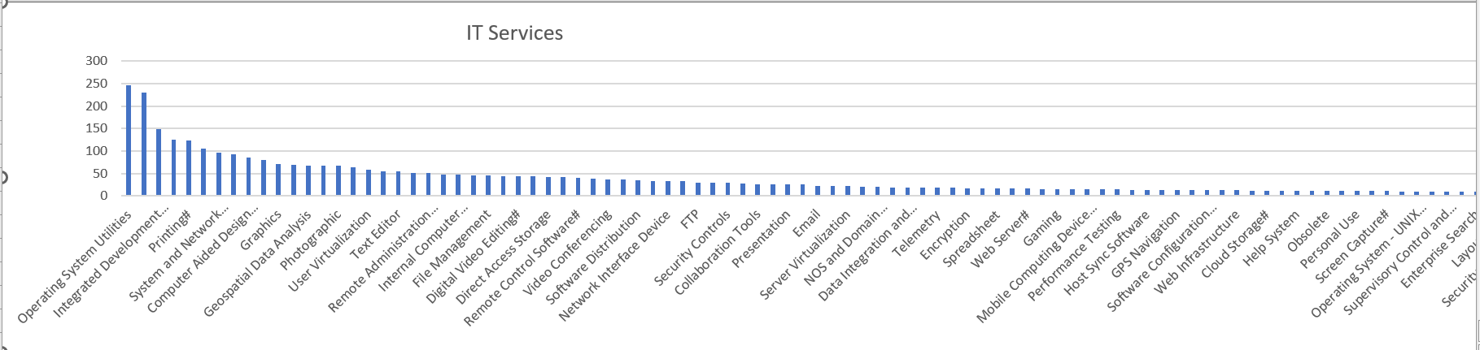
Column Charts
Interim approach
Notes:
Here’s a slight improvement, but still with a high cognitive load.

Slide 8
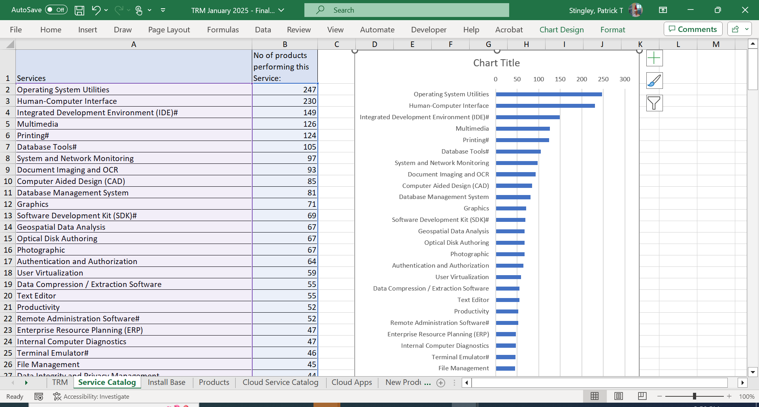
The Solution – Use a Bar Chart (Right tool for the job)
https://www.cuemath.com/data/bar-chart/
Notes:
You can actually change the chart type, by right clicking on the chart and selecting “Change Chart Type” and change it to bar chart, from Column Chart.

Slide 9
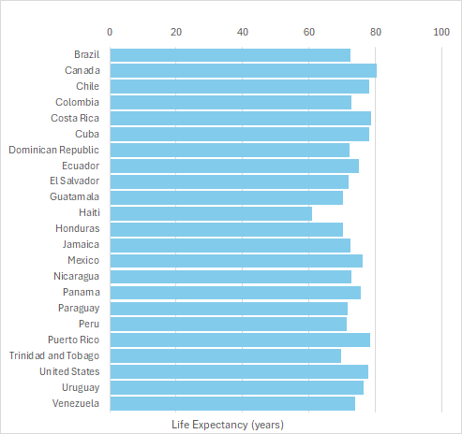
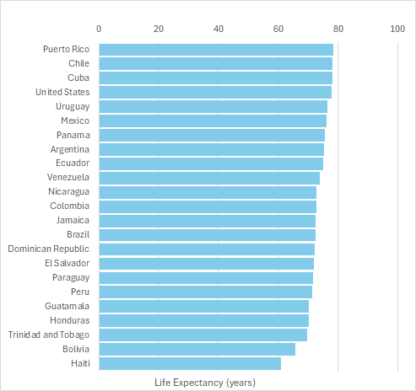
Bar Charts Order Dependent
(Fundamentals of Data Visualization (approx.))
Notes:
Diagrams made of bars, regardless of orientation, are order dependent. This makes me think about all of those scatter diagrams I’ve seen and wonder if there hadn’t been some way of making them line up.
(Question: Would one of those dimensionality reduction ML algorithms do this?)

Slide 10
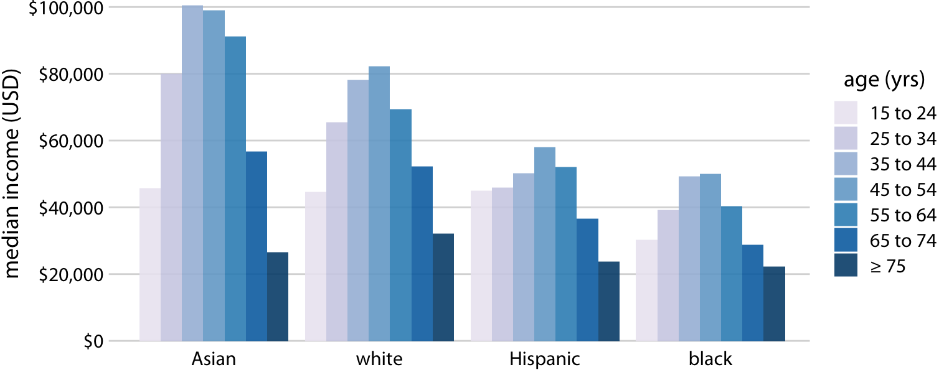
Grouped Bar Charts
2016 Median U.S. Annual household income versus age group and race
(Fundamentals of Data Visualization)
Notes:
Grouped Bar Charts, in this case, grouped column charts to be more accurate, can display a lot of information but can also hide trends. Apparently Asians generally have higher household incomes, but it drops off precipitously after 65. It’s hard to see this, but white households do better in these age groups. I have no idea why, the point is that it is difficult to spot trends among the same age groups but different races.

Slide 11
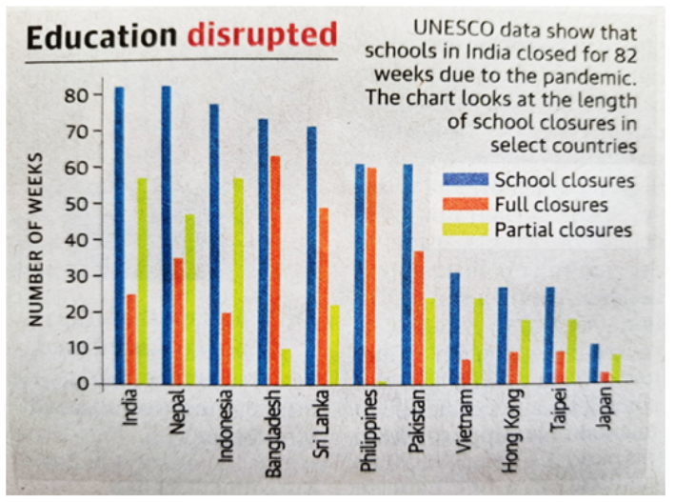
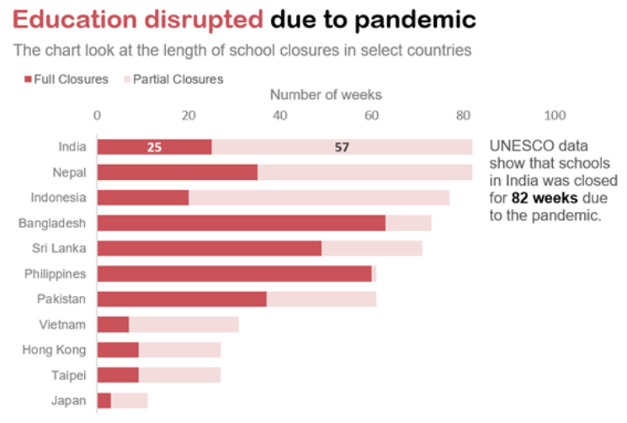
Stacked Bar Charts
Notice how a stacked bar chart can make the data more interpretable than a grouped bar chart
(Fundamentals of Data Visualization)
Notes:
Another form of the bar chart is the Stacked Bar Chart. In this slide, the stacked bar chart is used to good effect to represent the same information but in a much clearer way.

Slide 12
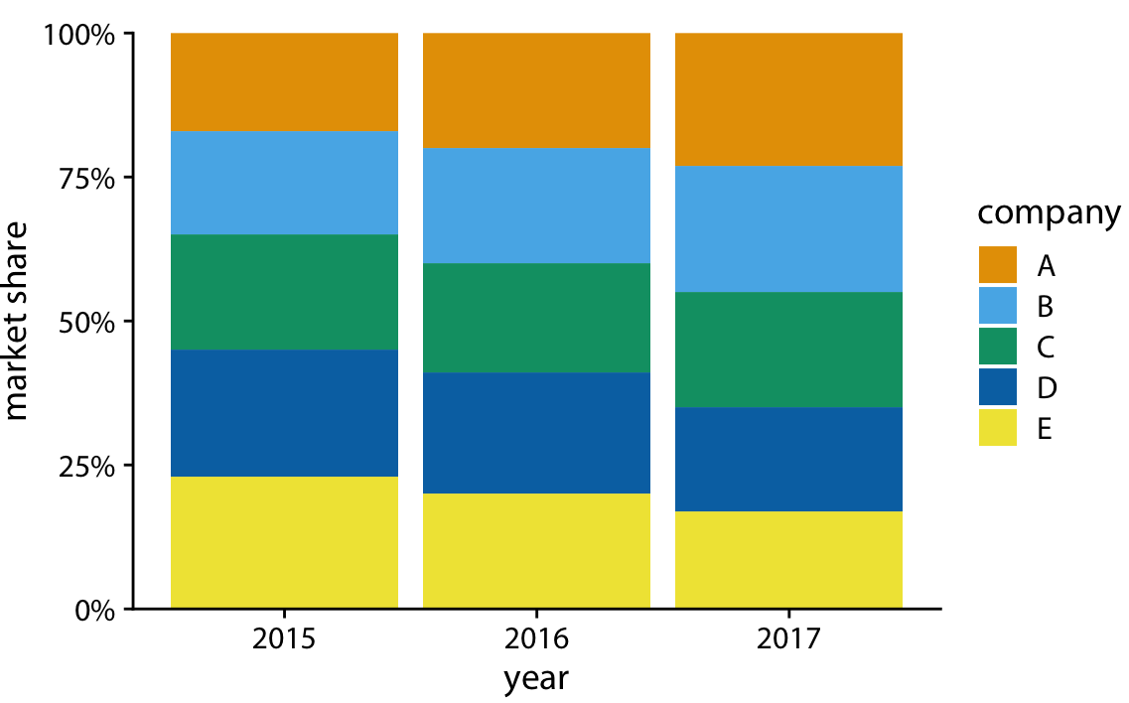
100% Stacked Bar Charts
(Fundamentals of Data Visualization)
Notes:
Another category of bar graph is the 100% stacked bar charts. In this case, the graphs describe how the entire market is divided among five companies. It’s useful when one wants to express how as one entity changes, others are affected, but it can be difficult to tell the relative percentages of change, for instance, it’s hard to tell how Company C did. Similarly, How did Company D do between 2015 and 2016? The fact that Company E declined during this period makes it difficult to compare the performance of other companies.

Slide 13
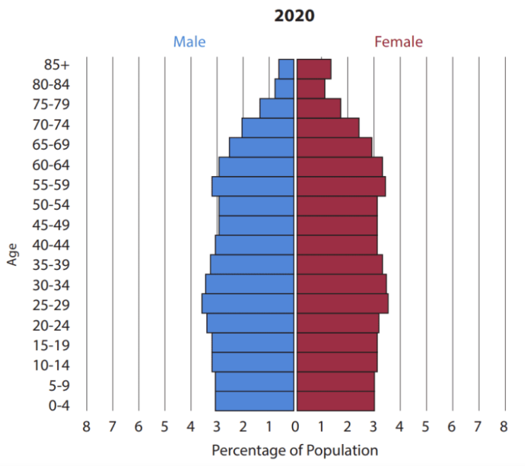
Horizontal Histogram – Population Pyramid
https://populationeducation.org/u-s-population-pyramids-over-time/
Notes:
Here’s one of my favorite kinds of a horizontal histogram called a population pyramid.
Note that it’s a histogram. It shows volume, and there are no spaces in between the bars.

Slide 14
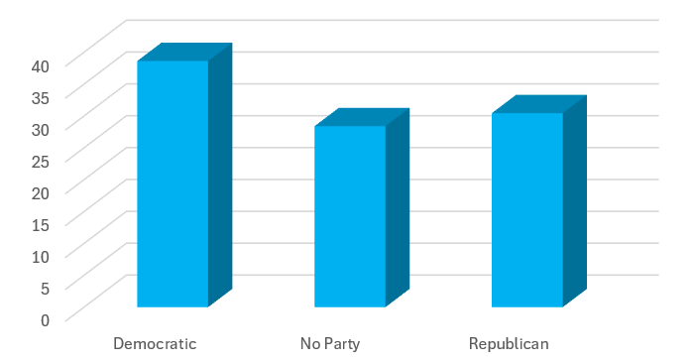
3D Bar (Column) Charts
(Fundamentals of Data Visualization)
Notes:
3D bar or column charts are not recommended. First, it’s hard to look at these and figure out precisely what the values are and second the additional cognitive load is greater, yet with no return on the investment.

Slide 15
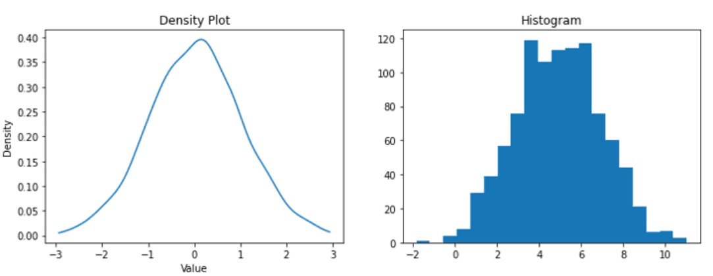
Density Plot
A histogram shows the counts of values in each range, while a density plot shows the proportion of values in each range.
(https://www.quanthub.com/how-do-histograms-compare-to-density-plots-in-terms-of-what-they-show/)
Notes:
A histogram shows the counts of values in each range, while a density plot shows the proportion of values in each range.

Slide 16
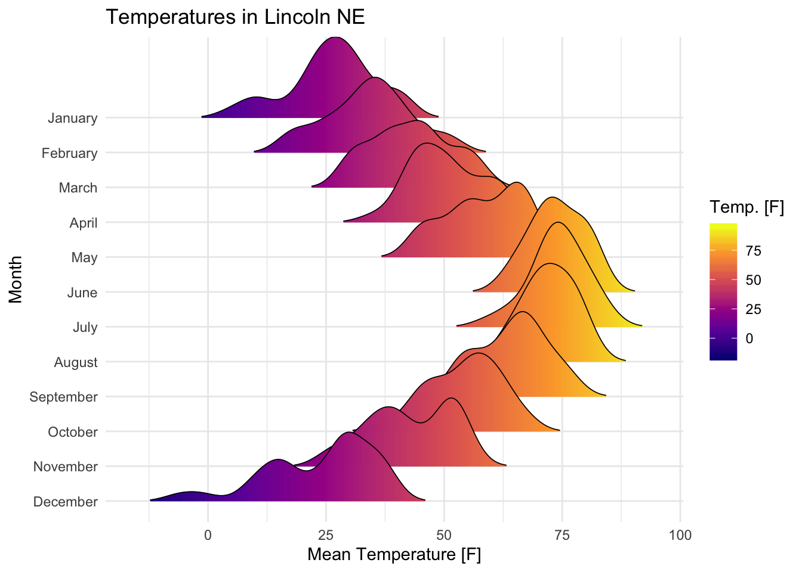
Overlapping Density or Ridgeline Plot
Notice how a
Collection of Density
Plots, called a Ridgeline
Plot can show how
Multiple dimensions of
data are related.
https://www.datanovia.com/en/blog/elegant-visualization-of-density-distribution-in-r-using-ridgeline/
Notes:
A histogram shows the counts of values in each range, while a density plot shows the proportion of values in each range.

Slide 17
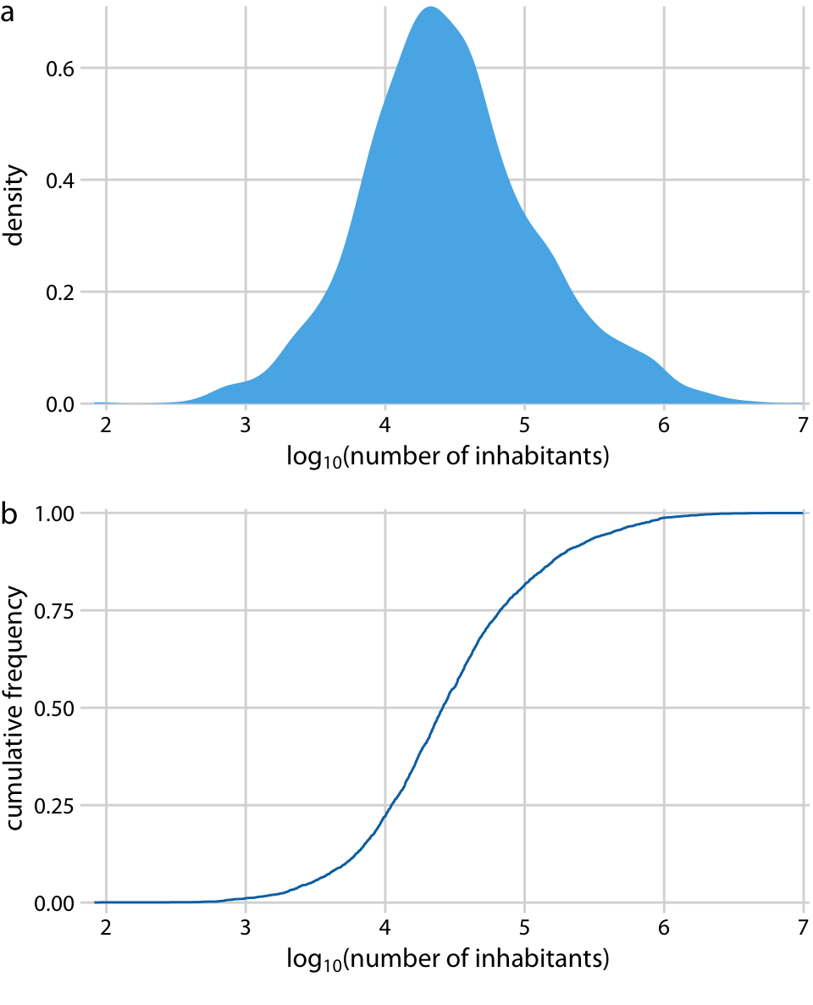
Cumulative Density Plot
Here’s an excellent diagram from Claus
Wilke, of UT Austin showing the
Relationship between essentially a Normal
Distribution and its Cumulative Density
Plot
AI Researchers will recognize the lower plot
As the Logistic Curve, also known as
SoftMax. This curve is used as an activation
Function in AI systems.
https://clauswilke.com/dataviz/ecdf-qq.html
Notes:
Here’s an excellent diagram from Claus
Wilke, of UT Austin showing the
Relationship between essentially a Normal
Distribution and its Cumulative Density
Plot
AI Researchers will recognize the lower plot
As the Logistic Curve, also known as
SoftMax. This curve is used as an activation
Function in AI systems.
The way it works in AI is things that are less
Than half are rounded down to zero
And the neuron doesn’t fire. If it’s above half
Then the neuron fires.
This is what a sigmoid looks like.
You’re compiling statistics to represent Logits

Slide 18
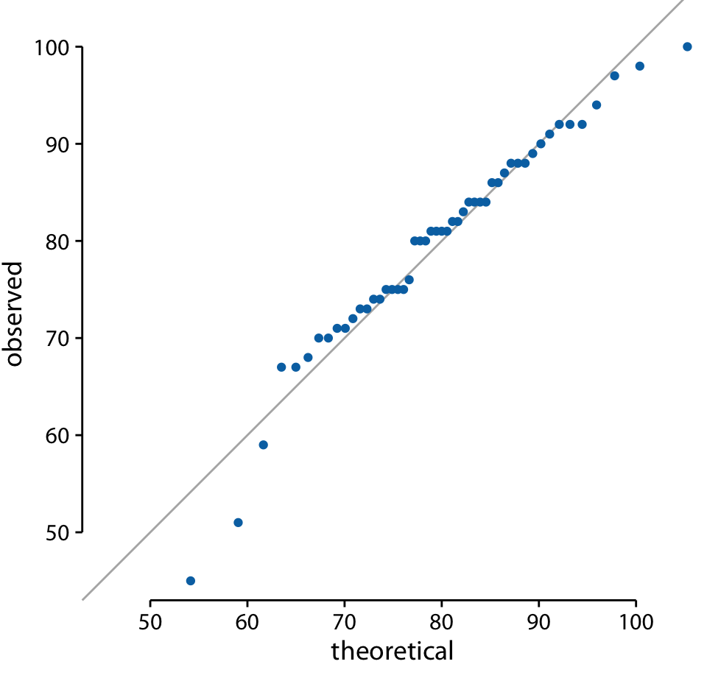
Quantile-Quantile Plot (Q-Q Plot)
The solid line here is not a regression line but indicates the points where x equals y, i.e., where the observed values equal the theoretical ones
https://clauswilke.com/dataviz/ecdf-qq.html
Notes:
The solid line here is not a regression line but indicates the points where x equals y, i.e., where the observed values equal the theoretical ones. To the extent that points fall onto that line, the data follow the assumed distribution (here, normal). We see that the student grades follow mostly a normal distribution, with a few deviations at the bottom and at the top (a few students performed worse than expected on either end).

Slide 19
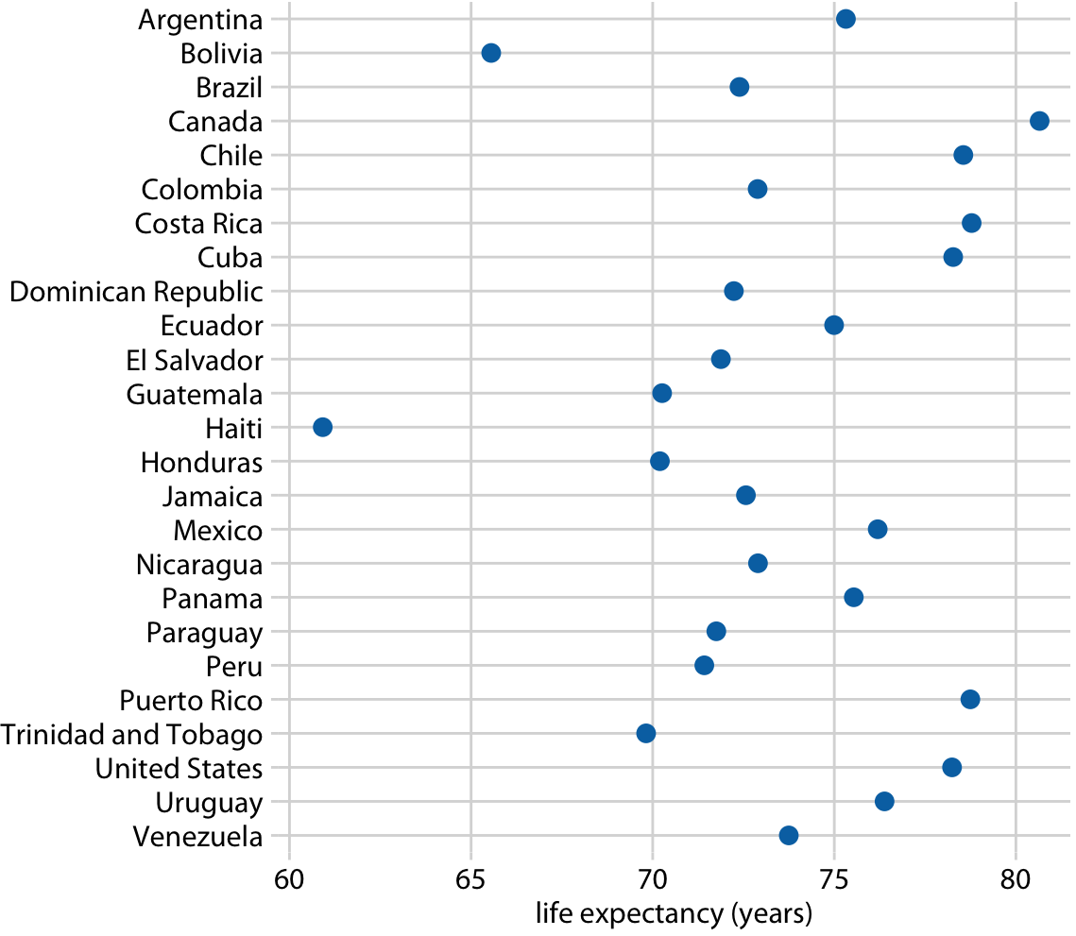
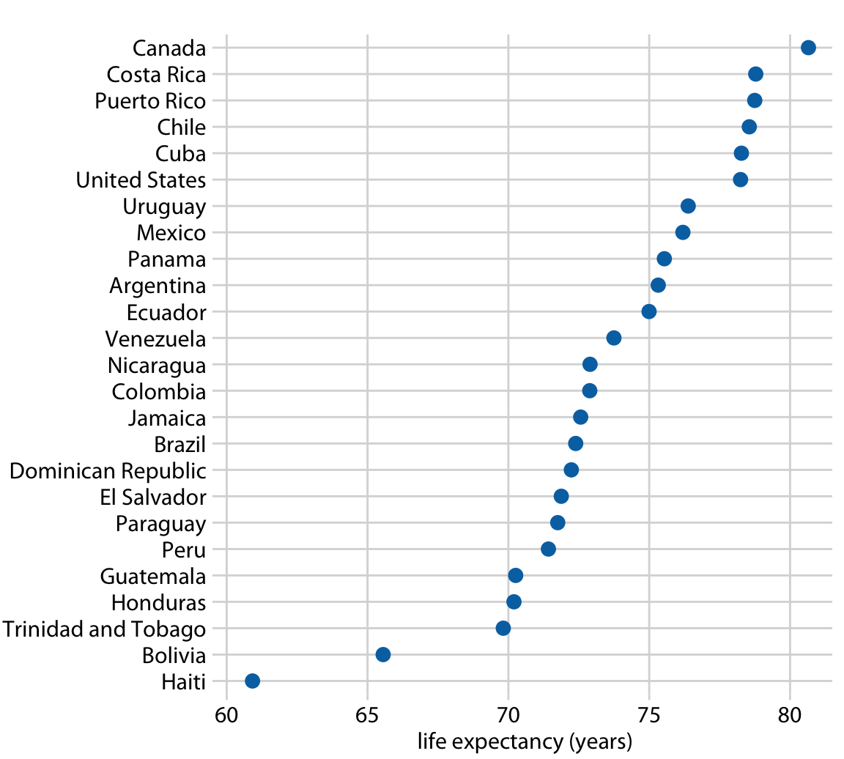
Dot Plot
https://www.cuemath.com/data/bar-chart/
Notes:
Diagrams made of bars, regardless of orientation, are order dependent. This makes me think about all of those scatter diagrams I’ve seen and wonder if there hadn’t been some way of making them line up.
(Question: Would one of those dimensionality reduction ML algorithms do this?)

Slide 20
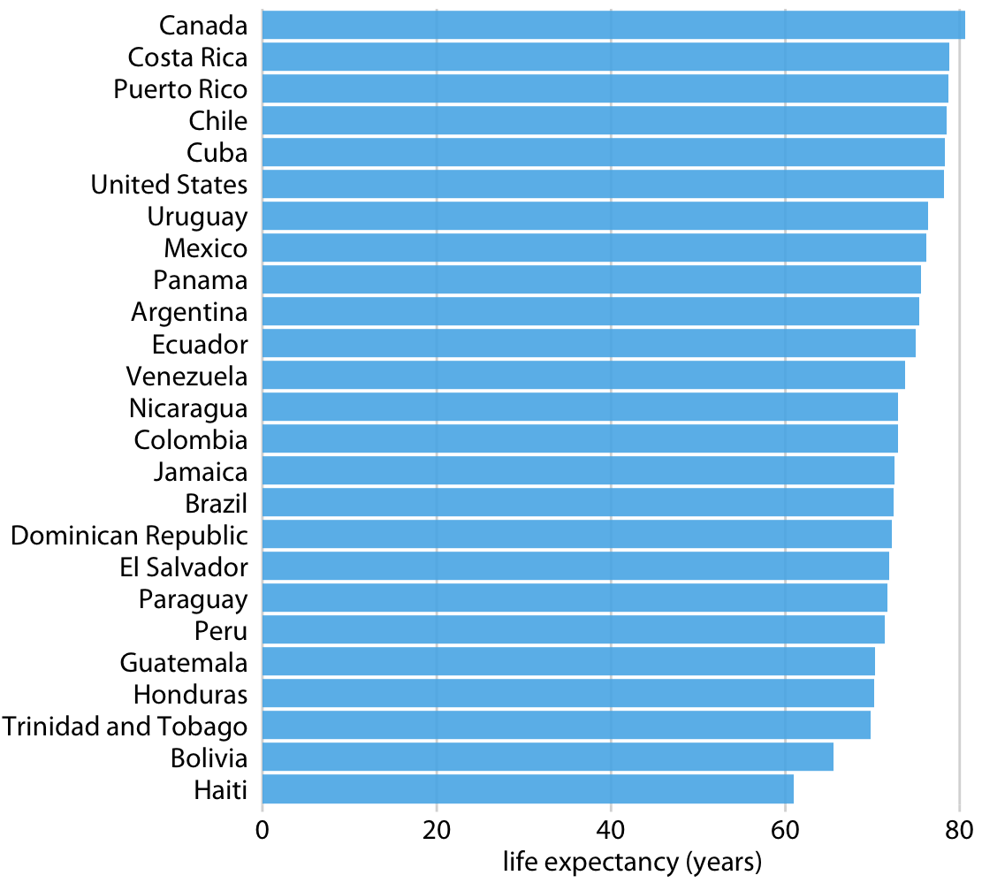
Comparison of Plotting Methods
https://www.cuemath.com/data/bar-chart/
Notes:
Notice in these diagrams how the Dot Plot eliminated the first 50 years of life to concentrate the viewer’s attention on the differences in lifespan. Compare this to the bar chart to the right.
In this case, the 50 years took up a lot of space but offered little information. Contrast this to the graph of entertainers we saw in Class 1.

Slide 21
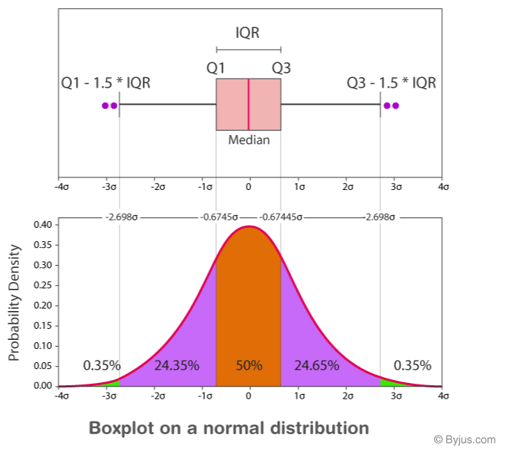
Box Plot
Notes:
Uncertainty

Slide 22
Excel Dashboard Demo
Notes:
Diagrams made of bars, regardless of orientation, are order dependent. This makes me think about all of those scatter diagrams I’ve seen and wonder if there hadn’t been some way of making them line up.
(Question: Would one of those dimensionality reduction ML algorithms do this?)

Slide 23
PowerBI
Please install the free version of PowerBI before next class
https://powerbi.microsoft.com/get-started

